Slide 1
Chapter 5: The Relational Data Model and Relational Database Constraints

Slide 2
Chapter 3 Outline
5.1 – The Relational Data Model and Relational Database Constraints
5.2 – Relational Model Constraints and Relational Database Schemas
5.3 – Update Operations, Transactions, and Dealing with Constraint Violations

Slide 3
5.1 – The Relational Data Model and
Relational Database Constraints

Slide 4
The Relational Data Model
Relational model
Based on Relational Algebra and Relational Calculus
First commercial implementations available in early 1980s.
Has been implemented in a large number of commercial systems.

Slide 5
Relational Model Concepts
Represents data as a collection of relations
From relational algebra, a function is a relation
F(X, Y, Z) ≡ F X Y Z
Represents data as a table of values (tabular model)
Each Row (called a Tuple)
Represents a collection of related
data values that typically
corresponds to a real-world entity
or relationship
Each row represents a relationship instance
Each row represents an entity
Notes:
“relation” is a term from mathematical Set Theory
“relation” vs. “relationship”
"table" is a relational database implementation

Slide 6
Domains, Attributes, Tuples, and Relations
Domain D
Set of valid atomic values for each attribute
Atomic
Each value is indivisible
Specifying a domain
Data type
Range of values

Slide 7
Examples of Domains
Usa_phone_numbers: The set of ten-digit phone numbers valid in the U.S.
Social_security_numbers: The set of valid nine-digit Social Security numbers.
Names: The set of character strings that represent names of persons.
Grade_point_averages: The set of possible values of computed grade point averages; must be a real number 0 to 4.
Employee_ages: The set of possible ages of employees in a company; e.g. must be an integer between 15 and 80.
Notes:
Domains may be more restrictive than Data Type
Requirements change. Phone numbers can change length, etc.

Slide 8
Domains, Attributes, Tuples, and Relations (cont’d.)
Relation schema R
Denoted by R(A1, A2, ..., An)
Made up of a relation name R and a list of attributes, A1, A2, ..., An
Attribute Ai
Name of a role played by some domain D in the relation schema R
Degree (or arity) of a relation
Number of attributes n of its relation schema

Slide 9
Relation Schema Example (three formats)
Text-based relation format with arity degree 7 (i.e. 7-ary)
STUDENT(Name, Ssn, Home_phone, Address, Office_phone, Age, Gpa)
Alternative text-based format using data types
STUDENT(Name: string, Ssn: string, Home_phone: string, Address: string, Office_phone: string, Age: integer, Gpa: real)
Alternative format as a schema diagram
STUDENT
Name | Ssn | Home_phone | Address | Office_phone | Age | Gpa

Slide 10
Domains, Attributes, Tuples, and Relations (cont’d.)
Relation (or relation state)
Set of n-tuples r = {t1, t2, … , tm}
Each n-tuple t
Ordered list of n values t = ⟨ v1, v2, … , vn ⟩
Each value vi, 1 ≤ i ≤ n, is an element of dom(Ai) or is a special NULL value
Based on a Relation Schema
Notes:
Each tuple (row) contains Values of Attributes
These are values at some point in time

Slide 11
Domains, Attributes, Tuples, and Relations (cont’d.)
Relation (or relation state) r(R)
Mathematical (i.e. Set Theory) relation of degree n on the domains dom(A1), dom(A2), … , dom(An)
Subset of the Cartesian product of the domains that define R:
r(R) ⊆ (dom(A1) × dom(A2) × ... × dom(An))
Notes:
Cartesian product of domains that define R contain ALL possible tuples

Slide 12
Domains, Attributes, Tuples, and Relations (cont’d.)
Cardinality
Total number of possible unique values in a domain
Total number of possible unique values (states) in a relation
Current relation state
Relation state at a given time
Reflects only the valid tuples that represent a particular state of the real world
Attribute names
Indicate different roles, or interpretations, for the domain
Notes:
Total number of tuples in a Cartesian Product
|(dom(A1)| × |dom(A2)| × ... × |dom(An))|
(dom(A1) × dom(A2) × ... × dom(An))

Slide 13
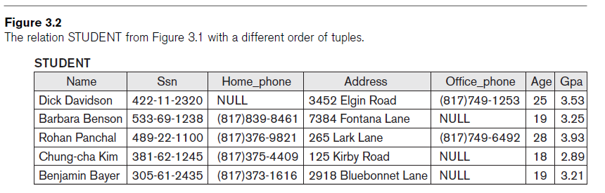
Characteristics of Relations
Ordering of tuples in a relation… NOPE!
Indices have an order, relations do not
Relation defined as a set of tuples
Set elements (members) have no order among them
Ordering of values within a tuple
Notes:
p.63
§3.1.2 Characteristics of Relations

Slide 14
Characteristics of Relations (cont’d.)
Alternative definition of a relation
Tuple considered as a set of (⟨attribute⟩, ⟨value⟩) pairs
Each pair gives the value of the mapping from an attribute Ai to a value vi from dom(Ai)
Order is explicitly not important
However, we use the first definition of relation by convention
Attributes and the values within tuples are ordered
Simpler notation

Slide 15
Characteristics of Relations
Values and NULLs in tuples
Each value in a tuple is atomic. This is called…
Flat relational model
First normal form assumption
Composite and multivalued attributes not allowed
Multivalued attributes must be represented by separate relations
Composite attributes are represented only by simple component attributes in basic relational model
Notes:
• Each value in a tuple is an atomic value; that is, it is not divisible into components with the framework of the basic relational model
• Hence, composite and multi-valued attributes (Ch.7) are now allows
Multi-valued attribute (e.g. academic degrees, children, etc.)
Composite attribute (e.g. address)
• This is sometimes called the “Flat Relational Model”
>> First Normal Form (Ch. 15, p.519

Slide 16
Characteristics of Relations
NULL values
Meanings for NULL values
Value unknown
Value exists but is not available
Attribute does not apply to this tuple (also known as value undefined)
Notes:
An important concept is that of NULL values
Perhaps someone does not have a cell phone or email address

Slide 17
Relational Model Notation
n-tuple t in a relation r(R)
Denoted by t = ⟨v1, v2, … , vn⟩
vi is the value corresponding to attribute Ai
Component values of tuples:
t[Ai] and t.Ai refer to the value vi in n-tuple t for attribute Ai
t[Au, Aw, … , Az] and t.(Au, Aw, … , Az) refer to the sub-tuple of values ⟨vu,vw, … , vz⟩ from t corresponding to the attributes specified in the list

Slide 18
5.2 – Relational Model Constraints and
Relational Database Schemas

Slide 19
Relational Model Constraints
What are “constraints”?
Restrictions on the actual values in a database state
Constraints are derived from the rules in the mini-world that the database represents
Also called integrity constraints – which help to insure data integrity of a database

Slide 20
Types of Constraints
Key constraints
Domain constraint
NULL value constraint
Entity integrity constraint
Referential integrity constraint

Slide 21
Key Constraints
No two tuples can have the same combination of values for all their attributes.
Superkey
Any combination of attributes that uniquely identify a record (tuple).
A superkey may (or may not) contain unnecessary attributes.
Every tuple has at least one superkey, i.e. the set of ALL attributes
Key
A minimal superkey of R
Removing any attribute A from key K leaves a set of attributes Kʹ that is not a superkey of R any more

Slide 22
Key Constraints (continued)
Candidate key
Relation schema may have more than one key
Each must be a minimal superkey
Primary key of the relation
Designated among candidate keys
Underline attribute
Other candidate keys are designated as unique keys (even though keys are unique by definition)
Notes:
In general, a relation schema may have more than one key.
In this case, each of the keys is called a CANDIDATE KEY

Slide 23
Domain Constraints
Typically include (but not limited to):
data types: integers, real numbers, strings, date,
A restricted range within a data type,
e.g. GPA is a real-valued number that is in the range 0.0–4.0, inclusive
A restricted pattern within a data type,
e.g. NAME is a string of alpha-only characters with max length of 25
A user-defined data types

Slide 24
Integrity, Referential Integrity, and Foreign Keys
Entity integrity constraint
No primary key value can be NULL
Notes:
#Resume Feb 1, 2018 001

Slide 25
Integrity, Referential Integrity, and Foreign Keys (cont’d.)
Foreign key rules to maintain referential integrity:
The attributes in FK have the same domain(s) as the primary key attributes PK
Value of FK in a tuple t2 of the current state r2(R2) either
occurs as a value of PK for some tuple t1 in the current state r1(R1)
or is NULL
Notes:
Foreign Key must have the same domain(s) as the primary key, but NOT necessarily the same Attribute Name

Slide 26
Other Types of Constraints
Semantic integrity constraints
May have to be specified and enforced on a relational database
Use triggers and assertions
“More common to check for these types of constraints within the application programs” – Elmasri
Notes:
Semantic
Adult vs. Minor => Age >= 18

Slide 27
Relational Databases and Relational Database Schemas
Relational database schema S
Set of relation schemas S = {R1, R2, … , Rm}
Set of integrity constraints IC
Relational database state
Set of relation states DB = {r1, r2, ..., rm}
Each ri is a state of Ri must satisfy all integrity constraints specified in the set IC

Slide 28
Relational Databases and Relational Database Schemas (cont’d.)
Invalid state
Does not obey all the integrity constraints, i.e. violates at least one integrity constraint
Valid state
Satisfies all the constraints in the defined set of Integrity Constraints (IC)

Slide 29
Other Types of Constraints (cont’d.)
Functional dependency constraint
Establishes a functional relationship among two sets of attributes X and Y in the same relation (table)
Value of X determines a unique value of Y: written X → Y
Example: All employees who have the same years of experience and rank should have the same salary.
This constraint can be specified as an FD:
Rank, YrsOfExper → salary
Ename | Rank | YrsOfExper | salary | Street No | City
Smith | 2 | 5 | 30000 | 203 Univ St | Ada

Slide 30
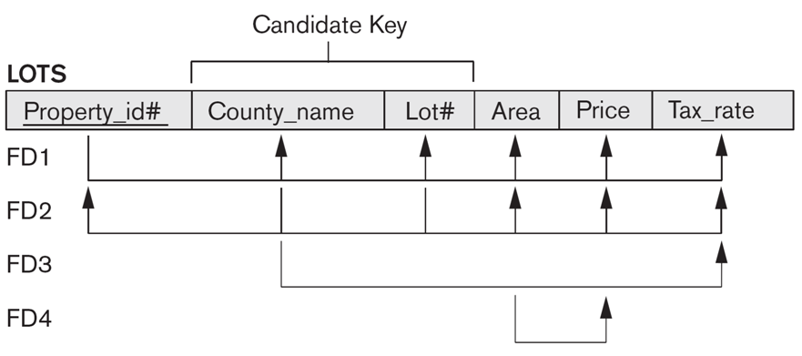
Other Types of Constraints (cont’d.)
Functional dependency constraint
For example, if we know someone’s SSN, then we can uniquely determine their Last_name,
i.e. Ssn → First_name, Last_name
This doesn’t go both ways! We may have two people whose last names and first names are the same, but they will have different Ssn values. i.e. First_name, Last_name ↛ Ssn
Another Example of FDs

Slide 31
3.3 – Update Operations, Transactions, and
Dealing with Constraint Violations

Slide 32
Update Operations, Transactions, and Dealing with Constraint Violations
Operations of the relational model can be categorized into Retrievals and Modifications
Retrieval
Query
Basic modification operations that change the states of relations in the database:
Insert
Delete
Update

Slide 33
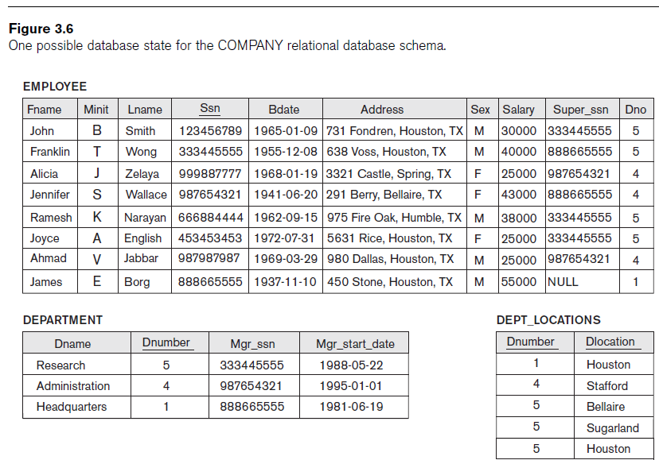
The Insert Operation
Provides a list of attribute values for a new tuple t that is to be inserted into a relation R
Can violate any of the four types of constraints
Domain Constraints
Key Constraints
Entity Integrity
Referential Integrity
If an insertion violates one or more constraints
Default option is to reject the insertion
Other options?
Notes:
Domain constraints can be violated if an attribute value is given that does not appear in the corresponding domain or is not of the appropriate data type.
Key constraints can be violated if a key value in the new tuple t already exists in another tuple in the relation r(R).
Entity integrity can be violated if any part of the primary key of the new tuple t is NULL.
Referential integrity can be violated if the value of any foreign key in t refers to a tuple that does not exist in the referenced relation.

Slide 34
The Delete Operation
Can violate only Referential Integrity
If tuple being deleted is referenced by foreign keys from other tuples
Options
Restrict – Reject the deletion
Set null or set default – Modify the referencing attribute values that cause the violation
Cascade – Propagate the deletion by deleting tuples that reference the tuple that is being deleted

Slide 35
The Update Operation
Necessary to specify a condition on attributes
of a relation
Select the tuple (or tuples) to be modified
If attribute not part of a primary key nor of a foreign key
Usually causes no problems
Updating a primary/foreign key
Similar issues as with Insert/Delete

Slide 36
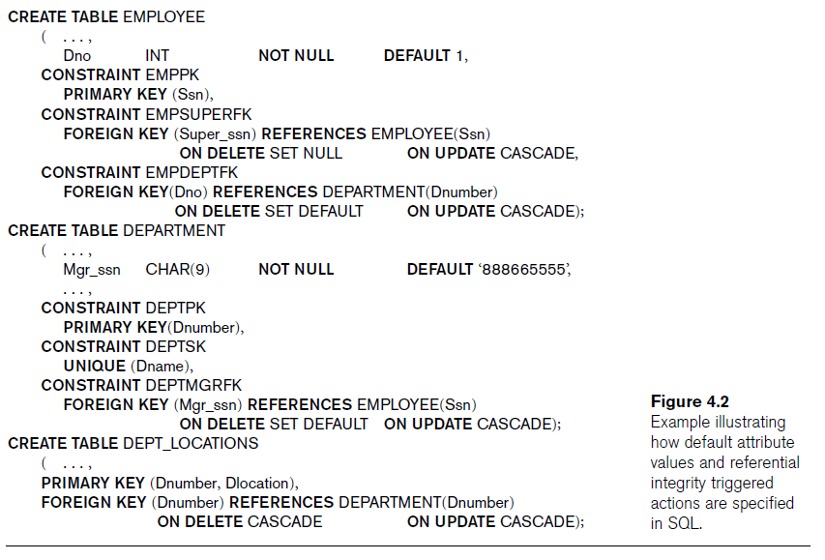

Slide 37
Chapter 5 Summary
Characteristics differentiate relations from ordinary tables or files
Classify database constraints into:
Inherent model-based constraints,
Explicit schema-based constraints, and
Application-based constraints
Modification operations on the relational model:
Insert, Delete, and Update

